Slide 1
Dashboard Creation in R

Slide 2
Dashboard
Dashboards and storyboards are used to communicate large amounts of data visually and quickly.
These dashboards can be created using R Markdown with the help of flexdashboard package.

Slide 3
Learning Objectives
What is R Markdown?
What is Flex dashboard?
How to install and load Flexdashboard?
R Markdown Template
Types of Layouts and examples
Components and usage
Listings using DT package
Example Clinical output
How to connect to RStudio Connect® account?
How to publish dashboard

Slide 4
WHAT IS R MARKDOWN?
R Markdown provides a framework to save and execute the code and to generate high quality reports in static and dynamic formats which can be shared

Slide 5
WHAT IS FLEXDASHBOARD?
Flexdashboard is an R package that allows you to use R Markdown to create a dashboard style output.
It handles the task of laying out a dashboard in HTML format.
It can be combined with shiny (an R package to create interactive web applications) to build reactive elements.
We can use flexdashboard to:
publish a group of related data visualizations as a dashboard
include wide variety of HTML widgets, R graphics, tabular data, value boxes, text annotations and gauges.
specify row and column-based layouts.
create storyboards with sequence of visualizations
use shiny to create dynamic/interactive visualizations

Slide 6
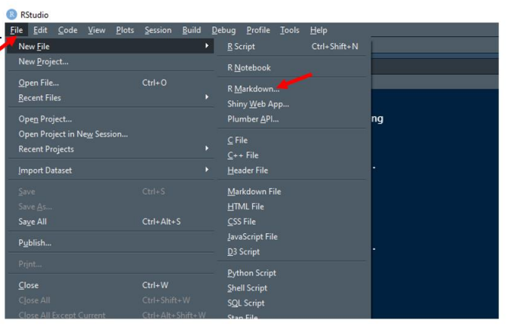
HOW TO INSTALL FLEXDASHBOARD IN RSTUDIO
Open RStudio and create a new R script file.
Step 1: Install flexdashboard library using, install.packages(“flexdashboard”)
Step 2: Once the package is installed, Go to File ->New
File -> select R Markdown.

Slide 7
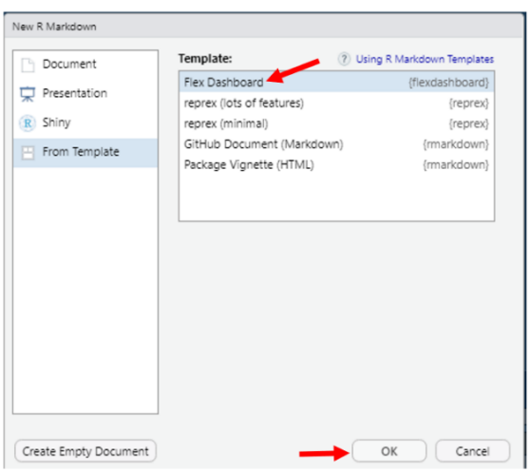
Step 3: A prompt window will open, a. From the Left Pane, Select “From Template” b. Under Template: Select “Flex Dashboard” c. Click ok Refer Figure 2
Step 4: A default R Markdown template will be loaded. Refer Figure 3 for default template.

Slide 8
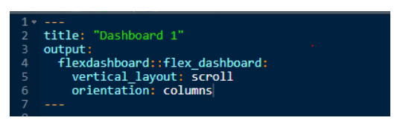
R MARKDOWN TEMPLATE
R Markdown template contains header called YAML header and code chunks.
YAML HEADER section is enclosed by three dashes as shown below.
It includes the options to control the dashboard.
By default, YAML header includes Title and output.
CODE CHUNKS starts with ```{r} and ends with 3 back ticks - ```.

Slide 9
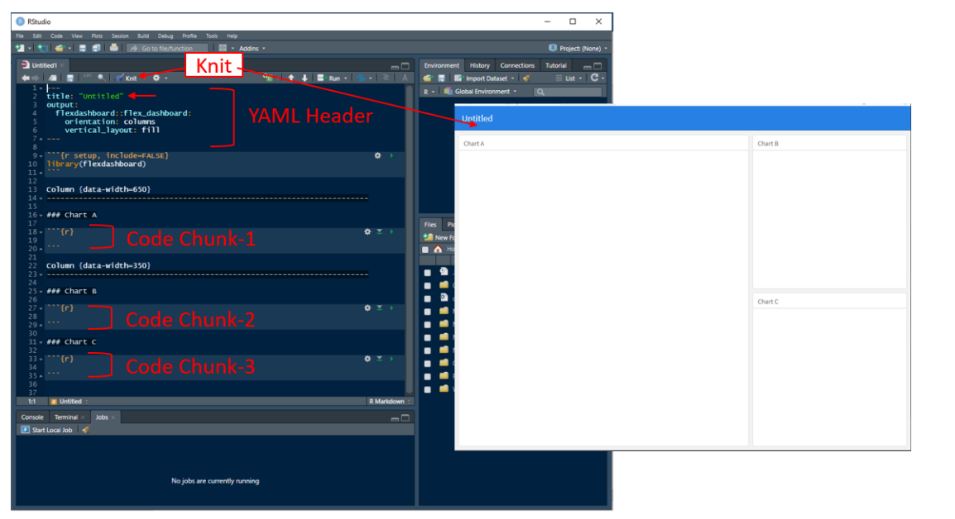
OUTPUT OF R MARKDOWN TEMPLATE
The default R Markdown template generates HTML output. As shown in screenshot below, the YAML header orientation is set to “columns”. The page is divided into 2 columns based on the template.

Slide 10
LAYOUTS AND EXAMPLES
Flexdashboard have different types of Layouts
Orientation
Layout by column
Layout by rows
b. Scrolling layout
c. Tabsets
create multiple pages using single hash (#), double dashes(===), or combination of both

Slide 11
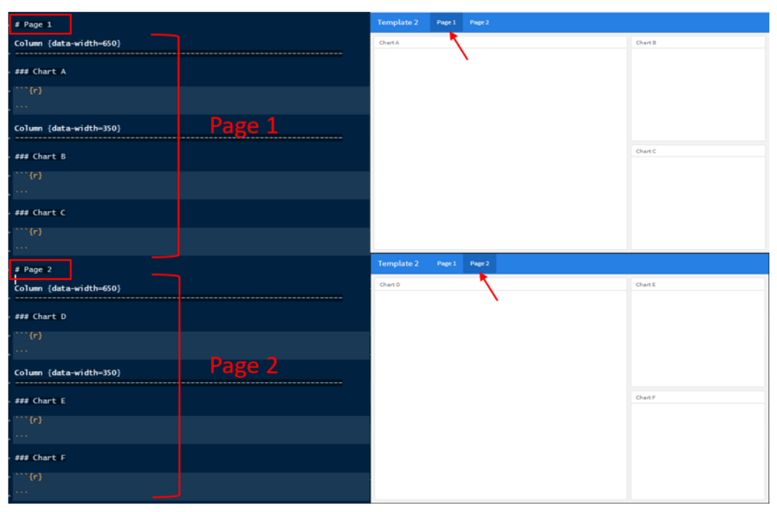
Template 1

Slide 12
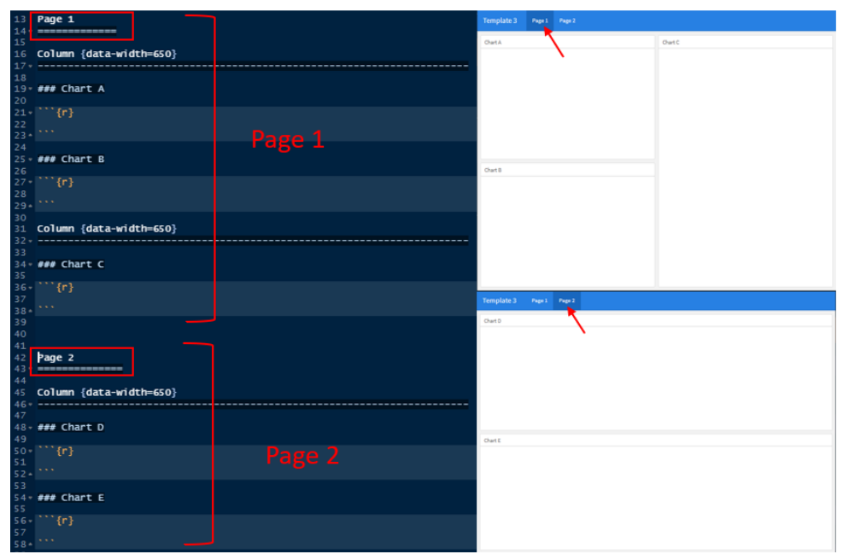
Template 2

Slide 13
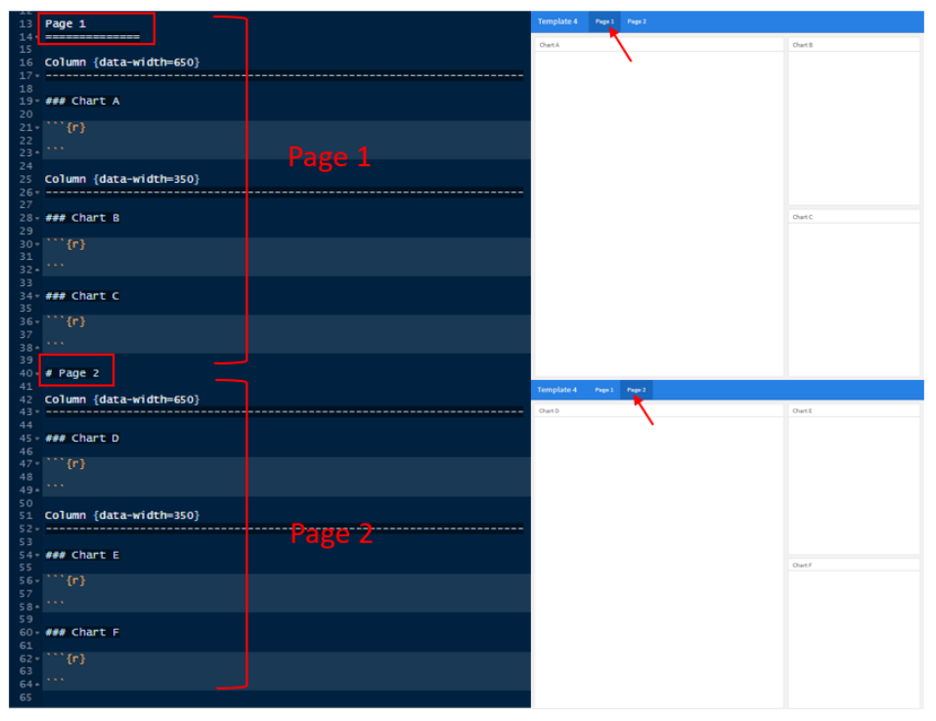
Template 3

Slide 14
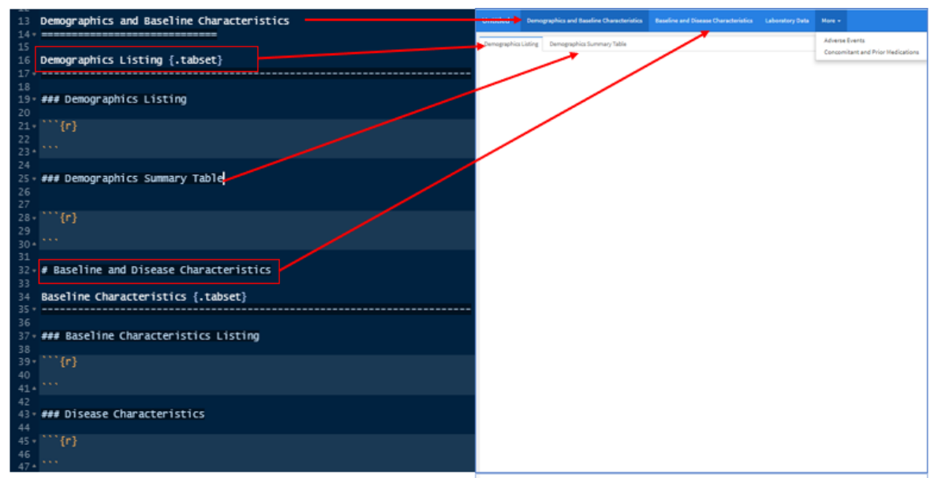
Flexdashboard provides flexibility in creating tabs in each page using {.tabset} attribute.

Slide 15
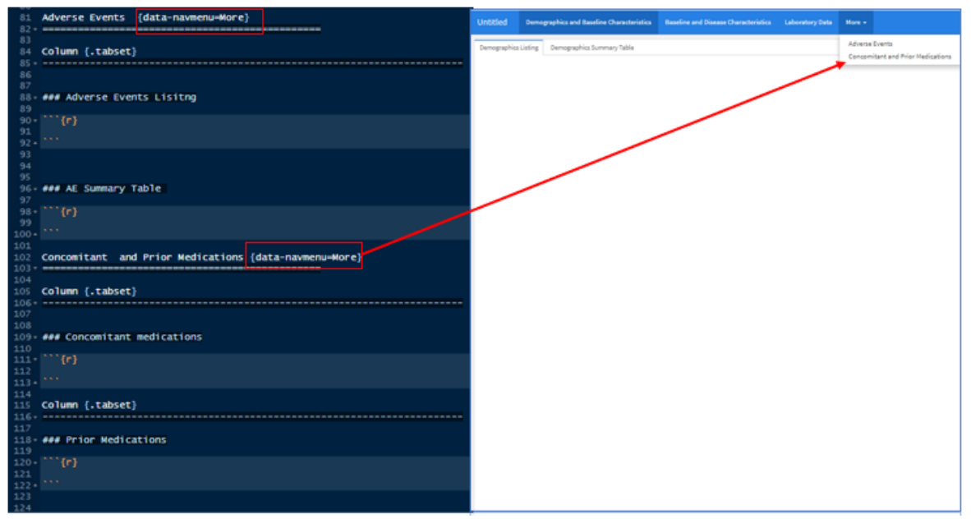
To add more pages with drop down like below screen shot for “Adverse Events” and “Concomitant and Prior Medications” use {data-navmenu=More} attribute

Slide 16
DASHBOARD COMPONENTS
Dashboard components provides the flexibility to control aesthetics of the dashboard like generating interactive data visuals, and provide features like summarizing, sorting, filtering, pagination, and labeling data.
HTML widgets
R Graphics
Tabular Data
Gauges
Navigation Bar
Text Annotations.

Slide 17
Thanks

